Slide 1

Healthcare
ODS MOE Process
Version 1, June 2015

Slide 2
Copyright

Slide 3

Agenda
Agenda
Overview
Background
Current Challenges

Slide 4
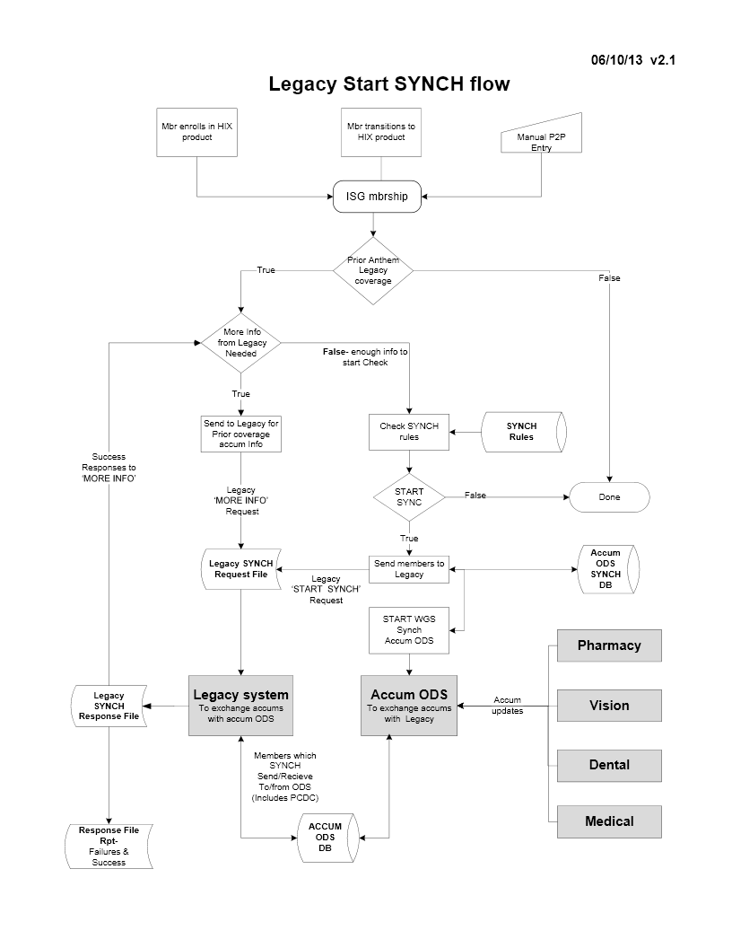
Overview
ODS MOE Process

Slide 5
Background
ODS MOE Process
Member Other Enrollment (MOE) process is used for legacy to HIX product transfers by Accum ODS.
The process uses membership trigger as input and outputs data in MOE file layout of 8380 bytes
The file contains all the prior contract information for the member spanning across multiple legacy systems.
The process uses EMPI query and getContractList services to get the prior legacy information.
The getContractList service in-turn uses searchMember service implementation for each legacy to gather information.
The services are existing ones and not created specifically for ODS.

Slide 6
Current Challenges
ODS MOE Process
For each member record, we get the member information for all the members under the subscriber. Matching the members to their coverage is difficult and prone to errors.
The process searches for all the prior coverage, not the most recent one. Hence there are a lot of partial data found errors if any one of those identified systems didn’t respond.
Each legacy system has their own implementation of search member so the data being returned is not uniform in details.
The process doesn’t always return the desired ISG/Legacy information. The resultant file has found to miss ISG or Legacy information sometimes.
Data like Legacy state/product missing from MOE and ODS currently takes it from other sources like XREF/Membership.
Member not found/Member failed response coming from Legacy during sync trigger process due to incorrect MOE information.

Slide 7
Resolution
ODS MOE Process
We are currently planning to replace the MOE process with a feed file from T&R team.

